Slide 1

Game Theory Seven
BNN Dynamical Systems
and
Fictitious Play
Jacob Wyngaard

Slide 2
Brown – von Neumann – Nash (BNN)
Dynamical Systems
$${\dot{p}}_{ij}=φ\left({Payoff}_{i}\left(e_{j}\right)−{Payoff}_{i}\left(p\right)\right)−p_{ij}\sum_{k}{φ\left({Payoff}_{i}\left(e_{k}\right)−{Payoff}_{i}\left(p\right)\right)}$$
Value of Pure Strategy $j$ minus Value of Current Strategy
$p_{ij}$ – the probability that the $i$th player chooses their $j$th strategy
$φ$ – an increasing function, Nash used ReLu function
This is a set of time-homogeneous differential equations

Slide 3
Brown - von Neumann- Nash
Example Dynamical System
Recall the two-player game:
Player 1 Payoff Matrix
Player 2 Payoff Matrix
Player 2
Player 2
A
B
A
B
1
7 | 2
3 | 4
1
1 | 6
8 | 2
Player 1
Player 1
2
2
Player 1 Strategy:${ p}^{1}=(x^{1},y^{1})$ Player 2 Strategy:${ p}^{2}=(x^{2},y^{2})$

Slide 4
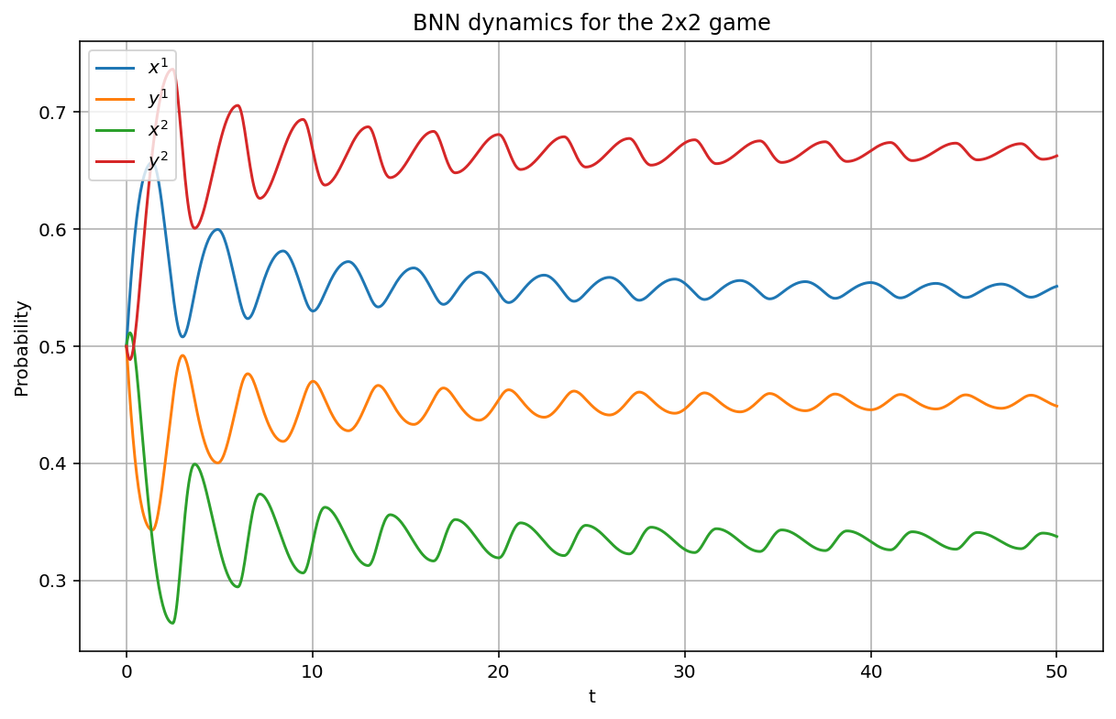
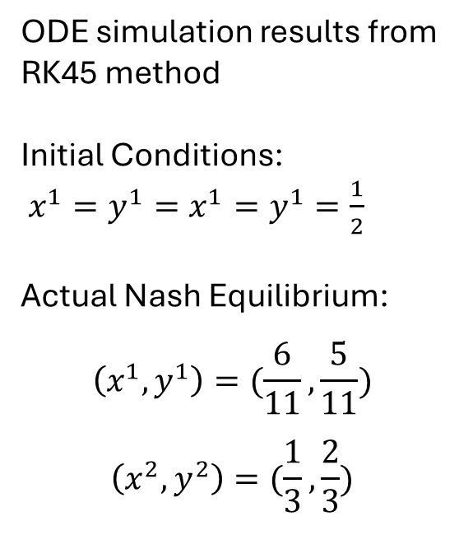
Brown - von Neumann- Nash
Example Dynamical System
ODE simulation results from RK45 method
Initial Conditions:
$x^{1}=y^{1}=x^{1}=y^{1}=\frac{1}{2}$
Actual Nash Equilibrium:
$$\left(x^{1},y^{1}\right)=(\frac{6}{11},\frac{5}{11})$$
$$\left(x^{2},y^{2}\right)=(\frac{1}{3},\frac{2}{3})$$

Slide 5
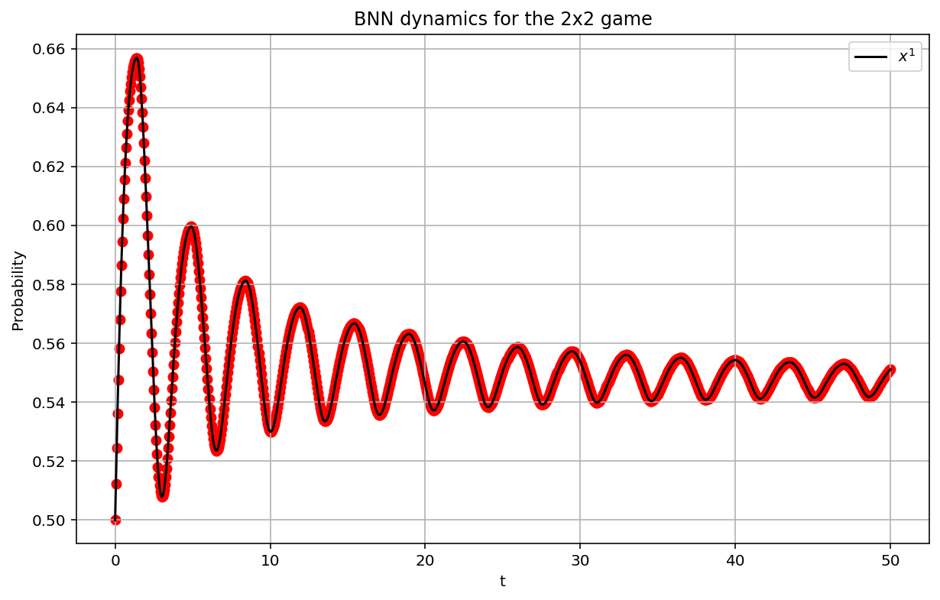
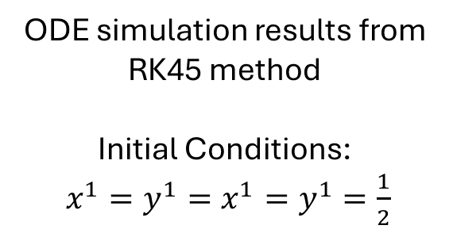

Step Size in Time
Considerations
Time Step $=.05$
ODE simulation results from RK45 method
Initial Conditions:
$x^{1}=y^{1}=x^{1}=y^{1}=\frac{1}{2}$

Slide 6
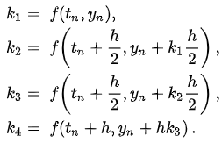


Convergence to Nash Equilibrium
What time step size do we actually want for the quickest convergence?
To determine the optimal step size, we need to switch to a non-adaptive ordinary differential equation solver:
Runge – Kutta Fourth Order (RK4) Method
Four Increments
ODE
Update Values

Slide 7
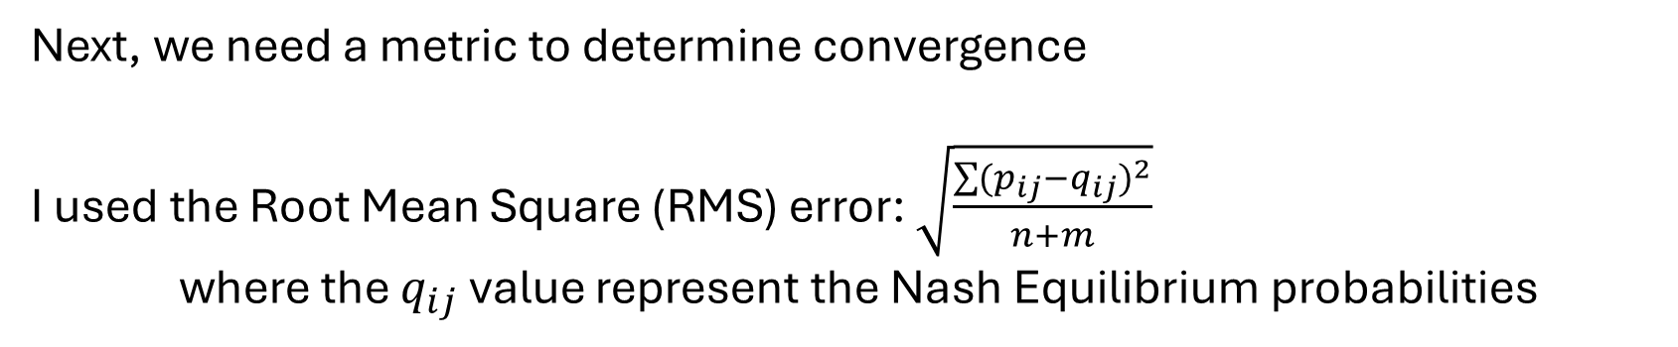
Convergence to Nash Equilibrium
Next, we need a metric to determine convergence
I used the Root Mean Square (RMS) error: $\sqrt{\frac{\sum{{(p_{ij}−q_{ij})}^{2}}}{n+m}}$
where the $q_{ij}$ value represent the Nash Equilibrium probabilities

Slide 8
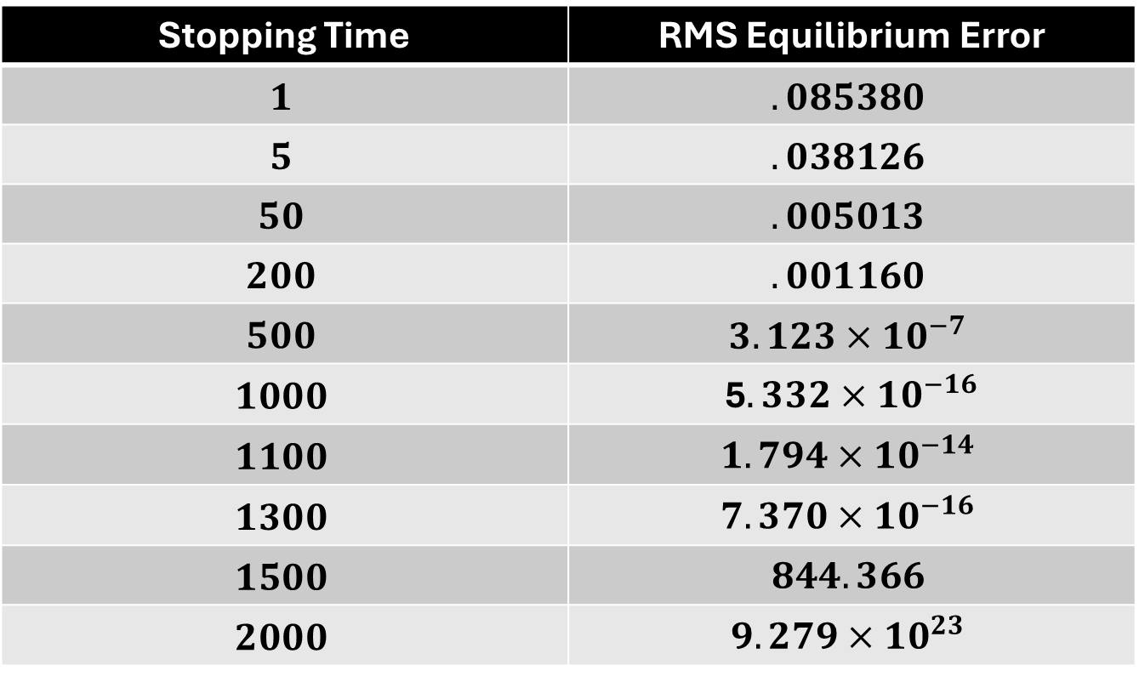
Convergence to Nash Equilibrium
Stopping Time | RMS Equilibrium Error
$$1$$ | $$.085380$$
$$5$$ | $$.038126$$
$$50$$ | $$.005013$$
$$200$$ | $$.001160$$
$$500$$ | $$3.123{×10}^{−7}$$
$$1000$$ | 5$.332{×10}^{−16}$
$$1100$$ | $$1.794{×10}^{−14}$$
$$1300$$ | $$7.370{×10}^{−16}$$
$$1500$$ | $$844.366$$
$$2000$$ | $$9.279{×10}^{23}$$
RK4 ODE Solver with 1000 Time Steps
Original Payoff Matrices

Slide 9
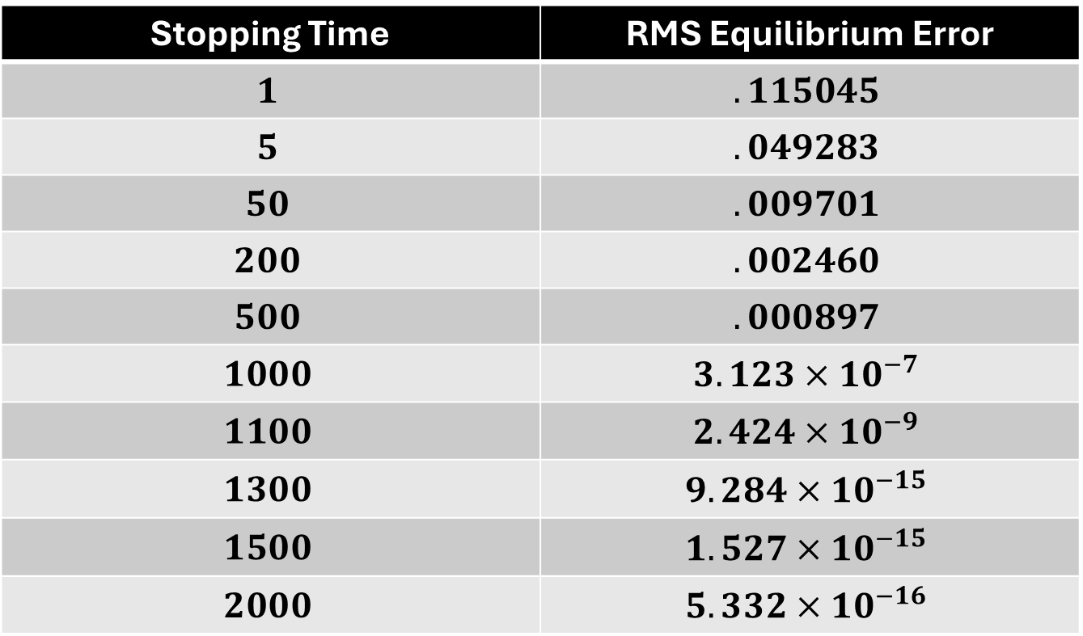
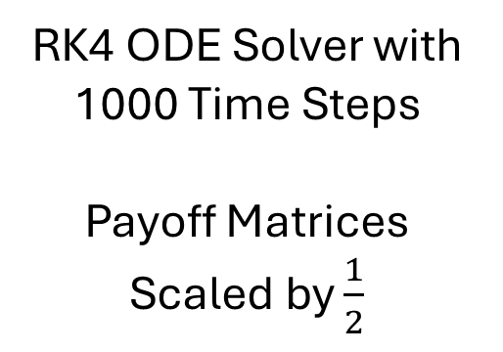
Convergence to Nash Equilibrium
Stopping Time | RMS Equilibrium Error
$$1$$ | $$.115045$$
$$5$$ | $$.049283$$
$$50$$ | $$.009701$$
$$200$$ | $$.002460$$
$$500$$ | $$.000897$$
$$1000$$ | $$3.123{×10}^{−7}$$
$$1100$$ | $$2.424{×10}^{−9}$$
$$1300$$ | $$9.284{×10}^{−15}$$
$$1500$$ | $$1.527{×10}^{−15}$$
$$2000$$ | $$5.332{×10}^{−16}$$
RK4 ODE Solver with 1000 Time Steps
Payoff Matrices Scaled by $\frac{1}{2}$

Slide 10
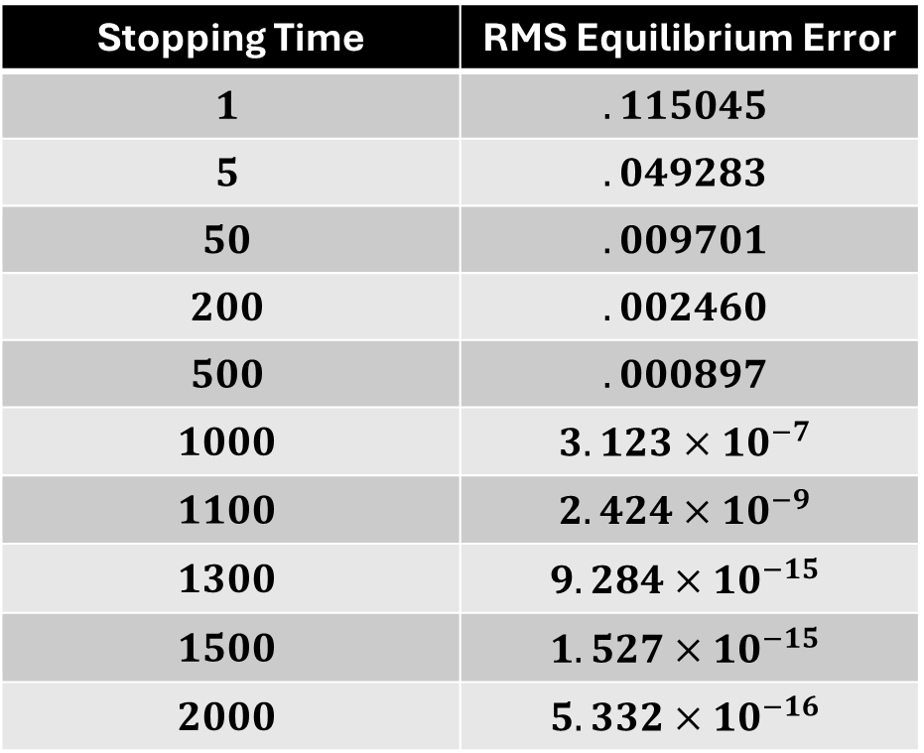
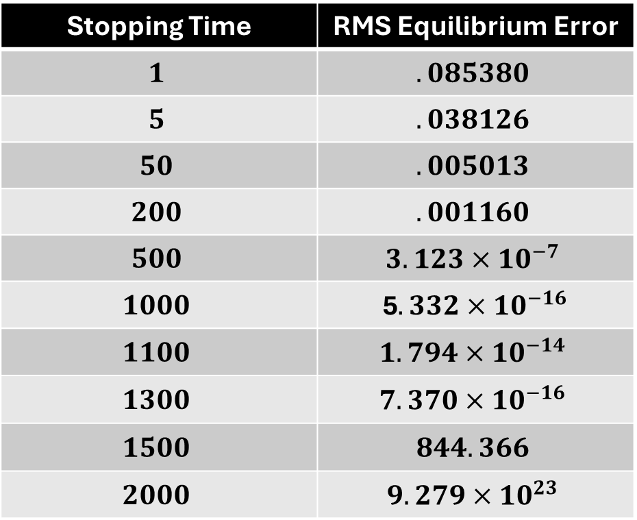
Convergence to Nash Equilibrium
Original Payoff Matrices
Payoff Matrices Scaled by $\frac{1}{2}$
Stopping Time | RMS Equilibrium Error
$$1$$ | $$.085380$$
$$5$$ | $$.038126$$
$$50$$ | $$.005013$$
$$200$$ | $$.001160$$
$$500$$ | $$3.123{×10}^{−7}$$
$$1000$$ | 5$.332{×10}^{−16}$
$$1100$$ | $$1.794{×10}^{−14}$$
$$1300$$ | $$7.370{×10}^{−16}$$
$$1500$$ | $$844.366$$
$$2000$$ | $$9.279{×10}^{23}$$
Stopping Time | RMS Equilibrium Error
$$1$$ | $$.115045$$
$$5$$ | $$.049283$$
$$50$$ | $$.009701$$
$$200$$ | $$.002460$$
$$500$$ | $$.000897$$
$$1000$$ | $$3.123{×10}^{−7}$$
$$1100$$ | $$2.424{×10}^{−9}$$
$$1300$$ | $$9.284{×10}^{−15}$$
$$1500$$ | $$1.527{×10}^{−15}$$
$$2000$$ | $$5.332{×10}^{−16}$$

Slide 11
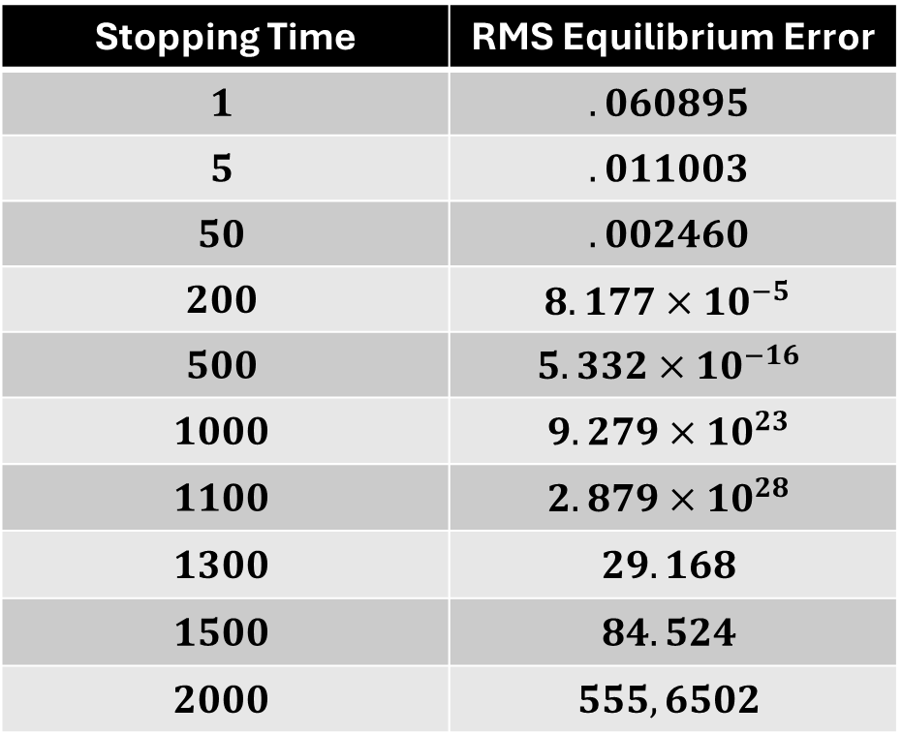
Convergence to Nash Equilibrium
Original Payoff Matrices
Payoff Matrices Scaled by $2$
Stopping Time | RMS Equilibrium Error
$$1$$ | $$.085380$$
$$5$$ | $$.038126$$
$$50$$ | $$.005013$$
$$200$$ | $$.001160$$
$$500$$ | $$3.123{×10}^{−7}$$
$$1000$$ | 5$.332{×10}^{−16}$
$$1100$$ | $$1.794{×10}^{−14}$$
$$1300$$ | $$7.370{×10}^{−16}$$
$$1500$$ | $$844.366$$
$$2000$$ | $$9.279{×10}^{23}$$
Stopping Time | RMS Equilibrium Error
$$1$$ | $$.060895$$
$$5$$ | $$.011003$$
$$50$$ | $$.002460$$
$$200$$ | $$8.177{×10}^{−5}$$
$$500$$ | $$5.332{×10}^{−16}$$
$$1000$$ | $$9.279{×10}^{23}$$
$$1100$$ | $$2.879{×10}^{28}$$
$$1300$$ | $$29.168$$
$$1500$$ | $$84.524$$
$$2000$$ | $$555,6502$$

Slide 12
Convergence to Nash Equilibrium
Since the system is time-homogeneous and depends linearly on the payoff matrices, scaling payoff matrices is equivalent to scaling time under the ReLU activation function
For the original set of payoff matrices, the ideal time step is approximately 1
Since the accuracy is heavily dependent on the time step, adaptive step size approaches like Runge – Kutta 45 (RK45) are preferred

Slide 13
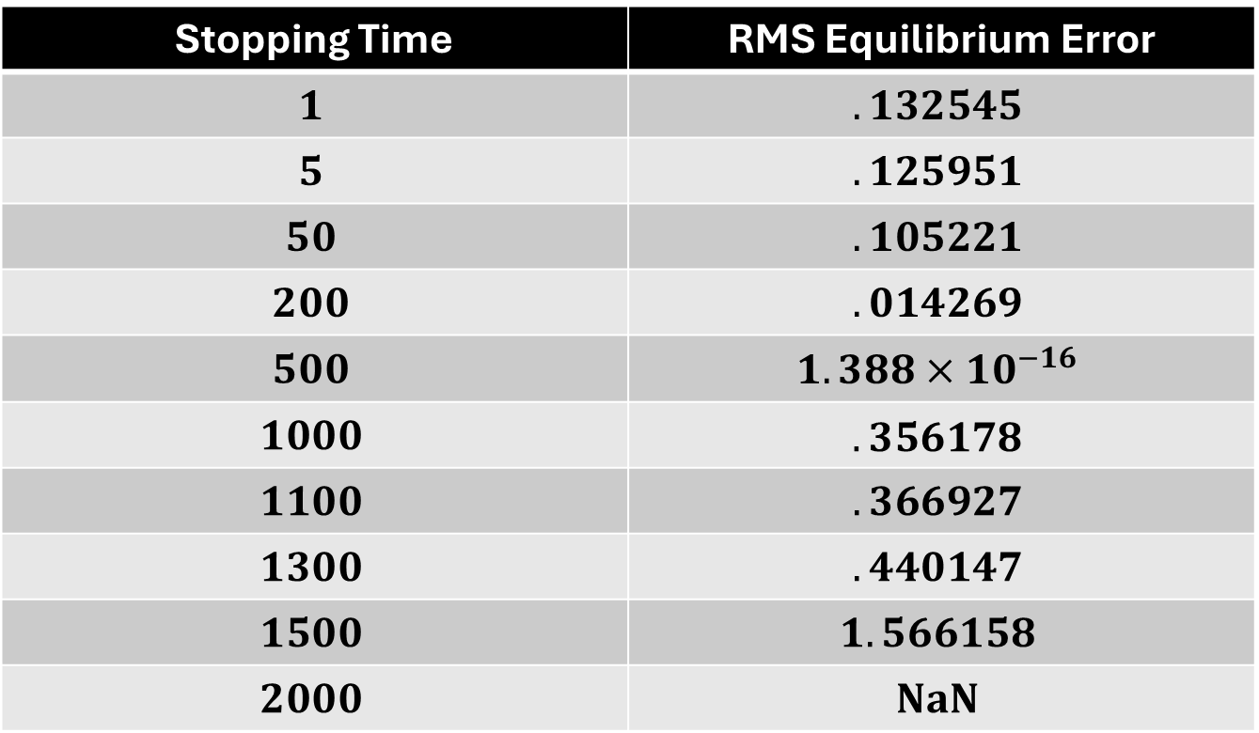
An Experiment
Stopping Time | RMS Equilibrium Error
$$1$$ | $$.132545$$
$$5$$ | $$.125951$$
$$50$$ | $$.105221$$
$$200$$ | $$.014269$$
$$500$$ | $$1.388{×10}^{−16}$$
$$1000$$ | $$.356178$$
$$1100$$ | $$.366927$$
$$1300$$ | $$.440147$$
$$1500$$ | $$1.566158$$
$$2000$$ | $$NaN$$
RK4 ODE Solver with 1000 Time Steps
Original Payoff Matrices
tanh Activation Function

Slide 14

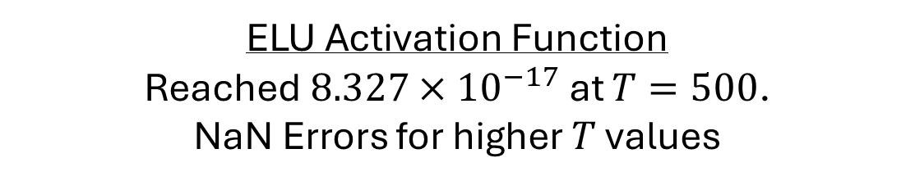


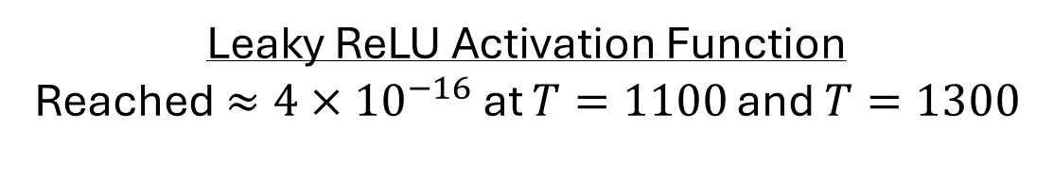
More Experiments
Sigmoid Activation Function
Lowest Error was $.083134$
All Experiments Done with:
RK4 ODE Solver with 1000 Time Steps
Original Payoff Matrices
Leaky ReLU Activation Function
Reached $≈4{×10}^{−16}$ at $T=1100$ and $T=1300$
SoftMax Activation Function
Lowest Error was $.021497$
GeLU Activation Function
Reached $6.206{×10}^{−17}$ at $T=1000$
Smooth
More sensitive to choosing correct step size
ELU Activation Function
Reached $8.327{×10}^{−17}$ at $T=500$.
NaN Errors for higher $T$ values

Slide 15
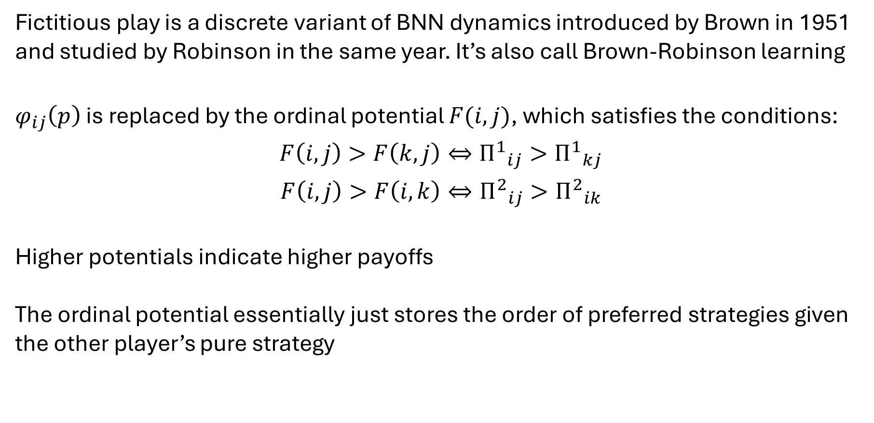
Fictitious Play
Introduction
Fictitious play is a discrete variant of BNN dynamics introduced by Brown in 1951 and studied by Robinson in the same year. It’s also call Brown-Robinson learning
$φ_{ij}\left(p\right)$ is replaced by the ordinal potential $F(i,j)$, which satisfies the conditions:
$$F\left(i,j\right)>F\left(k,j\right)⇔{Π^{1}}_{ij}>{Π^{1}}_{kj}$$
$$F\left(i,j\right)>F\left(i,k\right)⇔{Π^{2}}_{ij}>{Π^{2}}_{ik}$$
Higher potentials indicate higher payoffs
The ordinal potential essentially just stores the order of preferred strategies given the other player’s pure strategy

Slide 16
Fictitious Play
Games without Ordinal Potentials
Some games may not have ordinal potentials. Matching pennies example:
Many non-degenerate zero sum games do not have an ordinal potential
Player 1 Payoff Matrix
Player 2 Payoff Matrix
Player 2
Player 2
H
T
H
T
H
1 | -1
-1 | 1
H
-1 | 1
1 | -1
Player 1
Player 1
T
T

Slide 17
Fictitious Play
Ordinal Potentials
Player 2
Player 2
A
B
C
A
B
C
1
5 | 2 | 4
1 | 4 | 2
3 | 1 | 3
1
4 | 1 | 3
2 | 5 | 1
1 | 2 | 4
Player 1
Player 1
2
2
3
3
Player 1 Payoff Matrix
Player 2 Payoff Matrix
7 | 5 | 6
1 | 8 | 0
2 | 3 | 4
Ordinal Potential

Slide 18
Fictitious Play
Ordinal Potentials
Player 2
Player 2
A
B
C
A
B
C
1
5 | 2 | 4
1 | 4 | 2
3 | 1 | 3
1
4 | 1 | 3
2 | 5 | 1
1 | 2 | 4
Player 1
Player 1
2
2
3
3
Player 1 Payoff Matrix
Player 2 Payoff Matrix
Best Response to Other Player’s Strategy
Medium Response to Other Player’s Strategy
Worst Response to Other Player’s Strategy

Slide 19
Fictitious Play
Ordinal Potentials
Ordinal Potential
Player 2
Player 2
A
B
C
A
B
C
1
7 | 5 | 6
1 | 8 | 0
2 | 3 | 4
1
7 | 5 | 6
1 | 8 | 0
2 | 3 | 4
Player 1
Player 1
2
2
3
3
Player 1 Perspective
Player 2 Perspective
Ordinal Potential preserves preferences of both players

Slide 20
Fictitious Play
Construction of Ordinal Potentials
Player 2
Player 2
A
B
C
A
B
C
1
5 | 2 | 4
1 | 4 | 2
3 | 1 | 3
1
4 | 1 | 3
2 | 5 | 1
1 | 2 | 4
Player 1
Player 1
2
2
3
3
Player 1 Payoff Matrix
Player 2 Payoff Matrix
Preference Arrows
Player 1 Preference
Player 2 Preference

Slide 21
Fictitious Play
Construction of Ordinal Potentials
Preference Arrows
Player 1 Preference
Player 2 Preference
Iteratively:
Select a box with all arrows pointing outward
Label the box with the next number (start at 0)
Remove all outgoing arrows associated with that box
Similar to physics, we use gradients to uncover the underlying potential

Slide 22
Fictitious Play
Construction of Ordinal Potentials
 |  | 0
1 |  | 0
1 |  | 0
2
1 |  | 0
2 | 3

Slide 23
Fictitious Play
Construction of Ordinal Potentials
1 |  | 0
2 | 3 | 4
 | 5
1 |  | 0
2 | 3 | 4
 | 5 | 6
1 |  | 0
2 | 3 | 4
7 | 5 | 6
1 | 8 | 0
2 | 3 | 4

Slide 24
Fictitious Play
A Game without an Ordinal Potential
Player 2
Player 2
A
B
C
A
B
C
1
2 | 1 | 3
3 | 2 | 1
1 | 3 | 2
1
2 | 3 | 1
1 | 2 | 3
3 | 1 | 2
Player 1
Player 1
2
2
3
3
Player 1 Payoff Matrix
Player 2 Payoff Matrix
2 | 1 | 3
3 | 2 | 1
1 | 3 | 2
2 | 3 | 1
1 | 2 | 3
3 | 1 | 2

Slide 25
Fictitious Play
A Game without an Ordinal Potential
Player 1 Payoff Matrix
Player 2 Payoff Matrix
2 | 1 | 3
3 | 2 | 1
1 | 3 | 2
2 | 3 | 1
1 | 2 | 3
3 | 1 | 2
Player 1 Payoff Matrix
Player 2 Payoff Matrix
Preference Arrows
Player 1 Preference
Player 2 Preference

Slide 26
Fictitious Play
A Game without an Ordinal Potential
Preference Arrows
Player 1 Preference
Player 2 Preference
There is no box with each arrow pointing outward
We have saddle points, not minimums

Slide 27
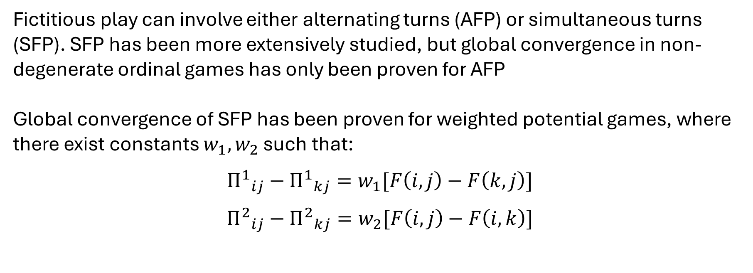
Fictitious Play
AFP vs SFP
Fictitious play can involve either alternating turns (AFP) or simultaneous turns (SFP). SFP has been more extensively studied, but global convergence in non-degenerate ordinal games has only been proven for AFP
Global convergence of SFP has been proven for weighted potential games, where there exist constants $w_{1},w_{2}$ such that:
$${Π^{1}}_{ij}−{Π^{1}}_{kj}=w_{1}[F\left(i,j\right)−F\left(k,j\right)]$$
$${Π^{2}}_{ij}−{Π^{2}}_{kj}=w_{2}[F\left(i,j\right)−F\left(i,k\right)]$$

Slide 28
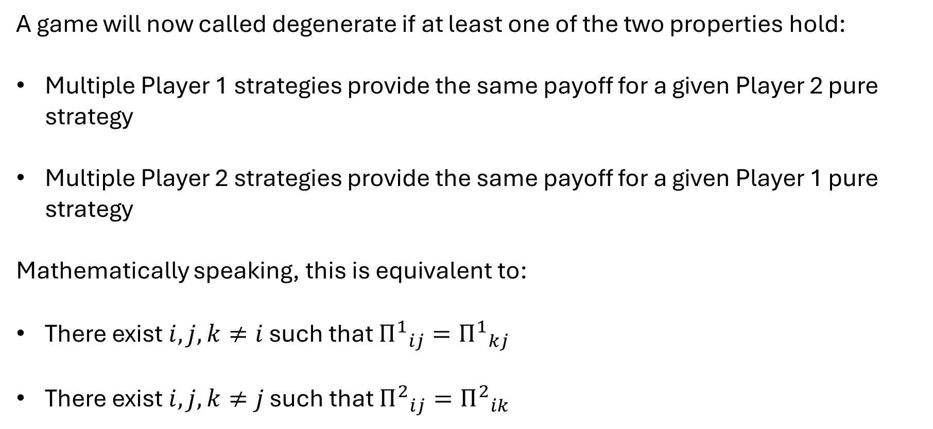
Degenerate Games
A game will now called degenerate if at least one of the two properties hold:
Multiple Player 1 strategies provide the same payoff for a given Player 2 pure strategy
Multiple Player 2 strategies provide the same payoff for a given Player 1 pure strategy
Mathematically speaking, this is equivalent to:
There exist $i,j,k≠i$ such that ${Π^{1}}_{ij}={Π^{1}}_{kj}$
There exist $i,j,k≠j$ such that ${Π^{2}}_{ij}={Π^{2}}_{ik}$
Non-degenerate games ensure the ordering stored in the ordinal potential is strict

Slide 29
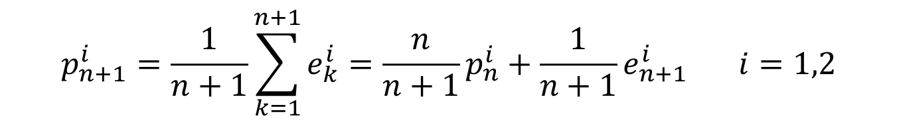
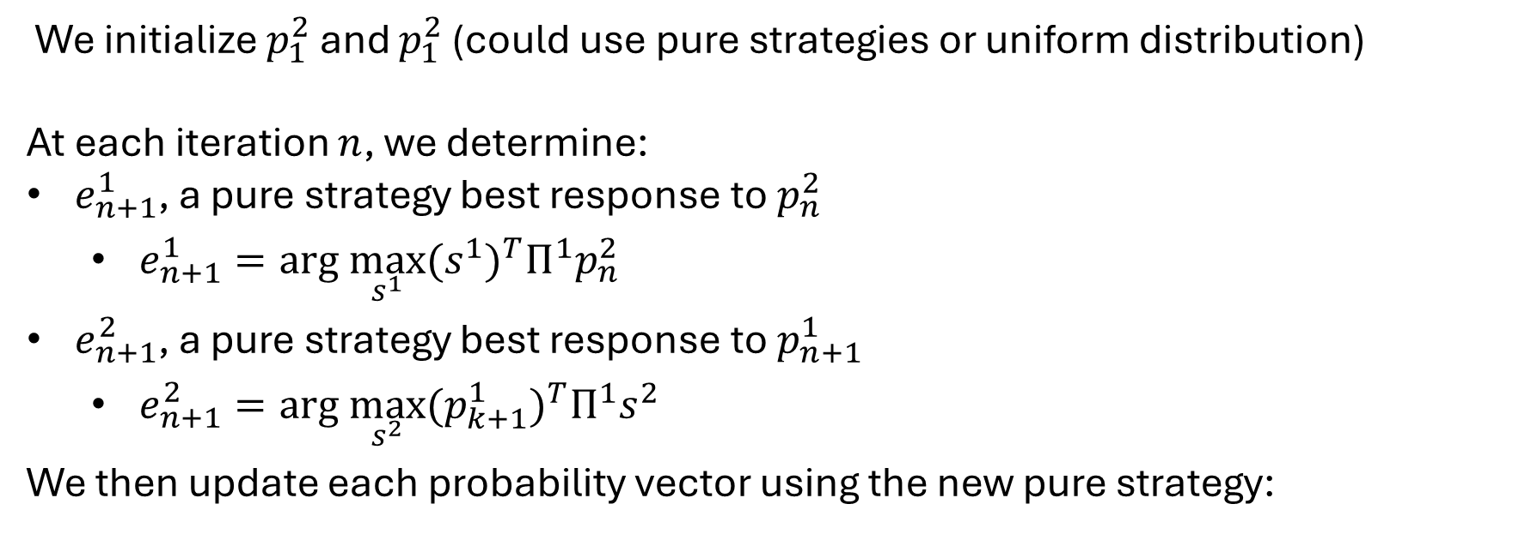
Fictitious Play
AFP Iterations
We initialize $p_{1}^{2}$ and $p_{1}^{2}$ (could use pure strategies or uniform distribution)
At each iteration $n$, we determine:
$e_{n+1}^{1}$, a pure strategy best response to $p_{n}^{2}$
$e_{n+1}^{1}=arg \max_{s^{1}}{{(s^{1})}^{T}Π^{1}p_{n}^{2}}$
$e_{n+1}^{2}$, a pure strategy best response to $p_{n+1}^{1}$
$e_{n+1}^{2}=arg \max_{s^{2}}{{(p_{k+1}^{1})}^{T}Π^{1}s^{2}}$
We then update each probability vector using the new pure strategy:
$$p_{n+1}^{i}=\frac{1}{n+1}\sum_{k=1}^{n+1}{e_{k}^{i}}=\frac{n}{n+1}p_{n}^{i}+\frac{1}{n+1}e_{n+1}^{i} i=1,2$$

Slide 30
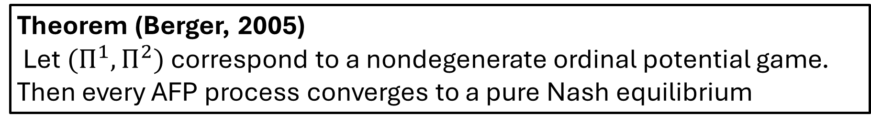
Convergence of Fictitious Play
Theorem (Berger, 2005)
Let$(Π^{1},Π^{2})$ correspond to a nondegenerate ordinal potential game. Then every AFP process converges to a pure Nash equilibrium
Proof on Latex Notes

Slide 31
Lemke Howson with Negative Expectation
Player 1 Payoff Matrix
Player 2 Payoff Matrix
Player 2
Player 2
A
B
C
A
B
C
1
-2 | 1 | -3
-3 | -2 | 1
1 | -3 | -2
1
-2 | -3 | 1
1 | -2 | -3
-3 | 1 | -2
Player 1
Player 1
2
2
3
3
*No strategies can be eliminated by strict dominance of pure strategies

Slide 32




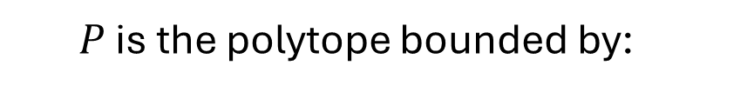

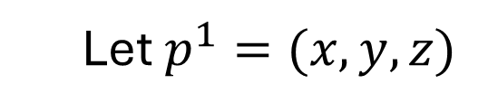


Lemke-Howson Algorithm with $3×3$ payoff matrices
$$P=\left\{p^{1}∈ℝ^{m} \right| {(Π^{2})}^{T}p^{1}≤1, p^{1}≥0\}$$
Player 2 Payoff Matrix
Let $p^{1}=(x,y,z)$
Player 2
$P$ is the polytope bounded by:
A
B
C
$$−2x+y−3z ≤1$$
1
-2 | -3 | 1
1 | -2 | -3
-3 | 1 | -2
$$−3x−2y+z≤1$$
Player 1
$$x−3y−2z ≤1$$
2
$$x ≥0$$
3
$$y ≥0$$
$$z ≥0$$

Slide 33
Lemke-Howson Algorithm with $3×3$ payoff matrices
$$P=\left\{p^{1}∈ℝ^{m} \right| {(Π^{2})}^{T}p^{1}≤1, p^{1}≥0\}$$
Let $p^{1}=(x,y,z)$
$P$ is the polytope bounded by:
Player 1 Polytope
$$−2x+y−3z ≤1$$
$$−3x−2y+z≤1$$
$$x−3y−2z ≤1$$
$$x ≥0$$
$$y ≥0$$
$$z ≥0$$

Slide 34



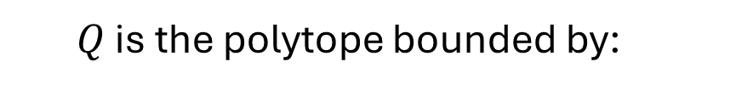

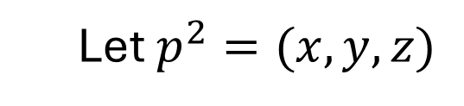


Lemke-Howson Algorithm with $3×3$ payoff matrices
Player 1 Payoff Matrix
$$Q=\left\{p^{2}∈ℝ^{n} \right|Π^{1}p^{2}≤1, p^{2}≥0\}$$
Let $p^{2}=(x,y,z)$
Player 2
$Q$ is the polytope bounded by:
A
B
C
$$−2x+y−3z ≤1$$
1
-2 | 1 | -3
-3 | -2 | 1
1 | -3 | -2
$$−3x−2y+z≤1$$
Player 1
2
$$x−3y−2z ≤1$$
3
$$x ≥0$$
$$y ≥0$$
$$z ≥0$$

Slide 35

Lemke-Howson Algorithm with $3×3$ payoff matrices
$$Q=\left\{p^{2}∈ℝ^{n} \right|Π^{1}p^{2}≤1, p^{2}≥0\}$$
Let $p^{2}=(x,y,z)$
$Q$ is the polytope bounded by:
Player 2 Polytope
$$−2x+y−3z ≤1$$
$$−3x−2y+z≤1$$
$$x−3y−2z ≤1$$
$$x ≥0$$
$$y ≥0$$
$$z ≥0$$

Slide 36
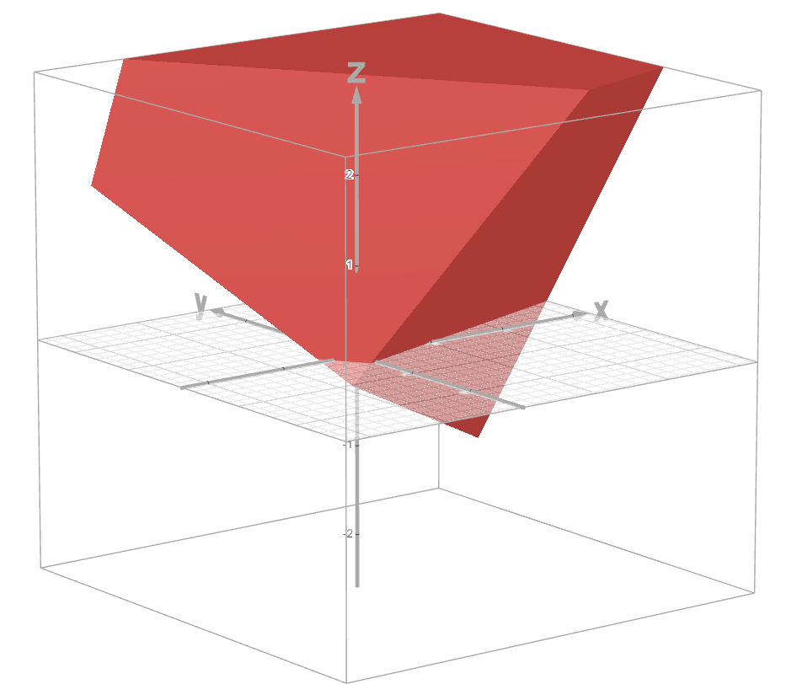
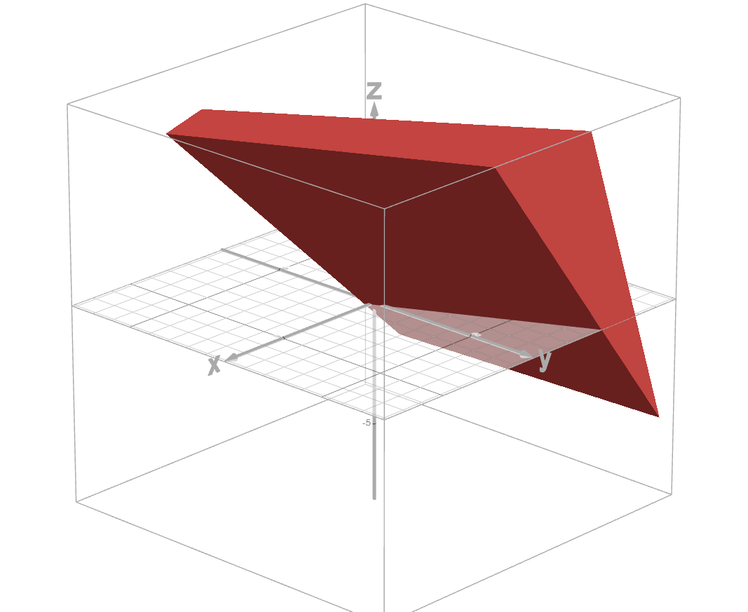
Lemke-Howson Algorithm with $3×3$ payoff matrices
Player 1 Polytope
Player 2 Polytope
Start with the pair of origin values
Note that this is not a vertex since we are not enforcing non-negativity constraints
Labels: 1, 2, 3
Labels: A, B, C

Slide 37
Lemke-Howson Algorithm with $3×3$ payoff matrices
Player 1 Polytope
Player 2 Polytope
“Drop” Label 1 from Player 1’s Polytope
Labels: 1, 2, 3
Labels: A, B, C

Slide 38
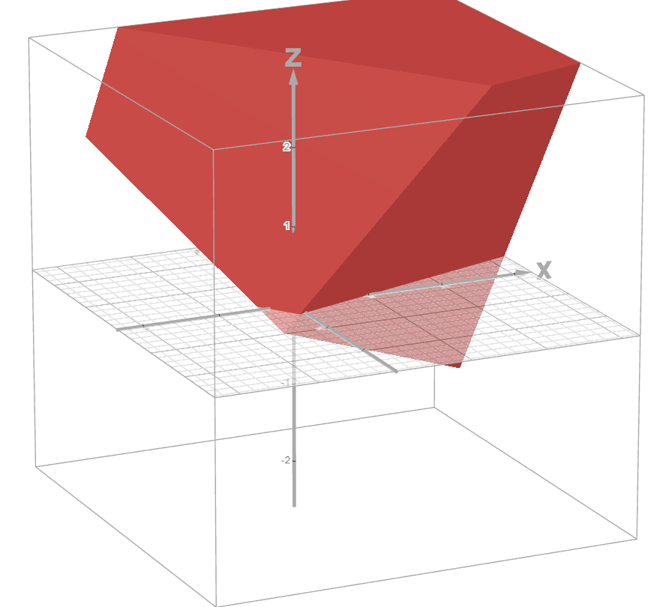


Lemke-Howson Algorithm with $3×3$ payoff matrices
Player 1 Polytope
Player 2 Polytope
“Recover” Label 1 using Player 2’s Polytope
Find adjacent vertex with:
$$−2x+y−3z=1$$
or:
$$−2x+y−3z=−1$$
We have to make a decision
Labels: 1, 2, 3
Labels: 1, B, C

Slide 39







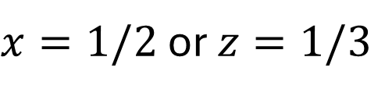








Lemke-Howson Algorithm with $3×3$ payoff matrices
Do we believe that Player 1 has positive expectation or negative expectation?
Positive Expectation
Negative Expectation
$$−2x+y−3z=1$$
$$−2x+y−3z=−1$$
$$y=1$$
$x=1/2$ or $z=1/3$
$$−2x+y−3z ≤1$$
$$−2x+y−3z ≤−1$$
$$−3x−2y+z≤1$$
$$−3x−2y+z≤−1$$
$$x−3y−2z ≤1$$
$$x−3y−2z ≤−1$$
$$x ≥0$$
$$x ≥0$$
$$y ≥0$$
$$y ≥0$$
$$z ≥0$$
$$z ≥0$$

Slide 40
Lemke-Howson Algorithm with $3×3$ payoff matrices
Do we believe that Player 1 has positive expectation or negative expectation?
Positive Expectation
Negative Expectation
$$−2x+y−3z=1$$
$$−2x+y−3z=−1$$
$$y=1$$
Pick another starting label to drop
$x=1/2$ or $z=1/3$
$$−2x+y−3z ≤1$$
$$−2x+y−3z ≤−1$$
$$−3x−2y+z≤1$$
$$−3x−2y+z≤−1$$
$$x−3y−2z ≤1$$
$$x−3y−2z ≤−1$$
$$x ≥0$$
$$x ≥0$$
$$y ≥0$$
$$y ≥0$$
$$z ≥0$$
$$z ≥0$$

Slide 41
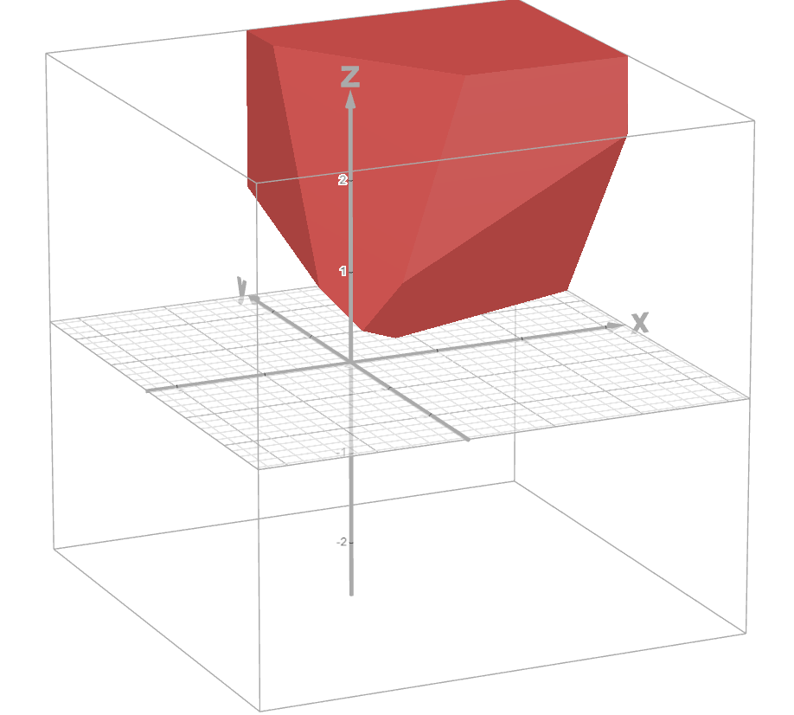
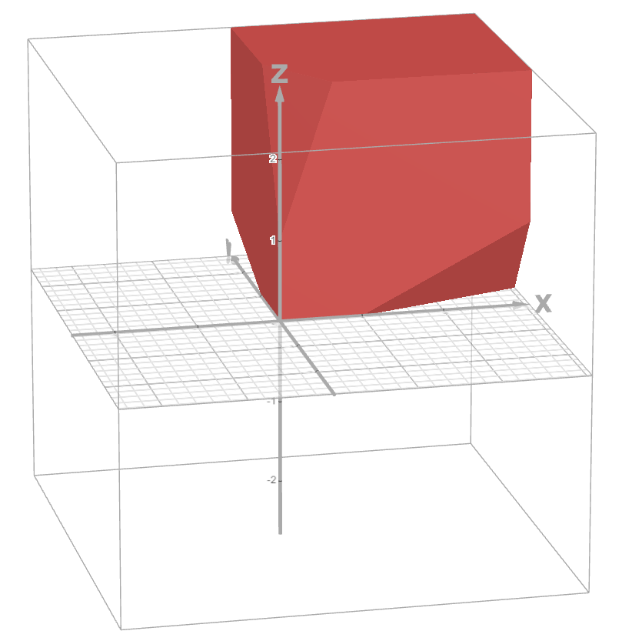
Lemke-Howson Algorithm with $3×3$ payoff matrices
Do we believe that Player 1 has positive expectation or negative expectation?
Positive Expectation
Negative Expectation
Positive Expectation Player 2 Polytope
Negative Expectation Player 2 Polytope

